Slide 1
Module II: Churn Analysis and Fraud Detection Churn Analysis and Prediction (Survival Modelling): Churn Prediction, Credit card Fraud Analysis: Imbalanced Data, Neural Network

Slide 2
Survival Modelling
Survival analysis, also known as time-to-event analysis, is a branch of statistics that studies the amount of time it takes before a particular event of interest occurs.
It was initially developed in biomedical sciences to understand the onset of certain diseases but is now used in engineering, insurance, and other disciplines.
Analysts at life insurance companies use survival analysis to estimate the likelihood of death at different ages, with health factors taken into account.
This information is used to estimate the probability of a policyholder outliving their policy, which, in turn, influences insurance premiums.

Slide 3
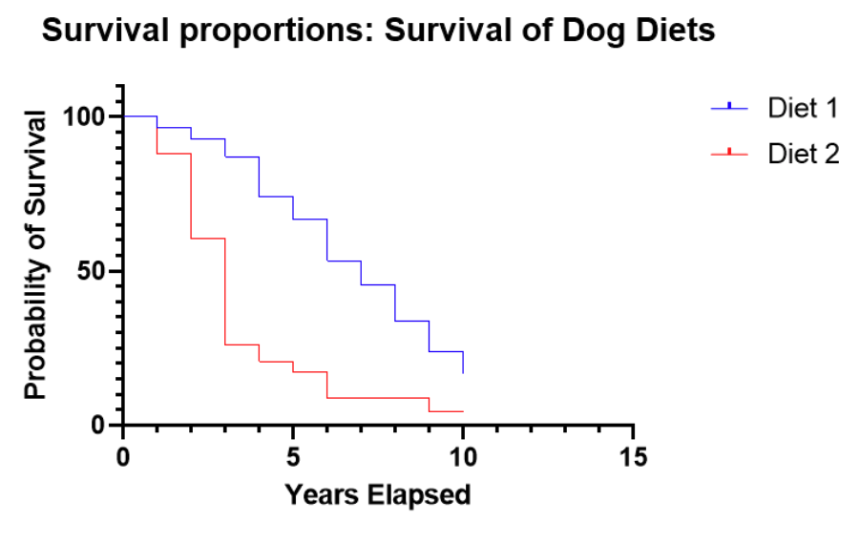

Slide 4
Statistical Analysis
This type of statistical analysis can be used to analyze how long it takes for something to happen before the event occurs or is completed. Survival analysis can be applied to customer churn rates and credit risk models which examine factors that affect repayment timelines for loans.
Customer churn survival analysis is commonly implemented using statistical methods like
Aalen additive hazard survival models
Event history survival models
Markov survival models
The log rank test survival models
Cox Proportional Hazards models

Slide 5
Statistical Survival Modelling
Survival models can analyze any type of survival data that researchers want to study, but most commonly this type of statistical model focuses on time-to-event or survival data. There are several different types of survival analysis, each of which is used to examine different types of events. The following represents some of the types of survival analysis models that can be used for customer churn:
Aalen additive hazard survival models are used to study the cumulative incidence function, which is defined as the probability that an event occurs within a specific duration of follow-up or observation period.
This type of survival analysis can be applied to customer churn data where survival refers to how long it takes for customers to cancel their subscriptions. This type of survival analysis can be applied when you want to study customers who have not yet canceled their service plans and look at factors that may be causing them to do so.
Some other real-life examples where Aalen additive hazard models got used include survival of human patients and survival analysis for medical research and survival rates in financial time series.
Event history survival models are survival models that are applied to survival data collected for more than one time period. This type of survival analysis can be used when event history data is collected over several different periods of time.
Event history survival analysis is often confused with the term survival curves, but these are actually two different types of survival analyses.
An example would be if you want to study customers who have canceled their service plans while they were still in the trial period. You would then use an Aalen additive hazards model on event history survival data, which can analyze how many customers canceled their subscription at various times during the trial period.

Slide 6
Statistical Survival Modelling
Markov survival models are survival models that can be used to study the timing between events.
Markov survival models are time-independent, which means they only consider the event history without considering any other previous information. This type of survival analysis is often applied in cohort studies where researchers do not have access to all of the customer data or may need to remove any customer data that may not be relevant to survival analysis.
An example would be if you want to study the number of customers who canceled their service plan, but only those who cancelled during a specific time period. The Markov survival model can then help determine how many customers or subscribers have been lost and at what point they left your subscription services.
The log rank test survival models are another type of survival analysis that is often used to compare and study survival rates between groups.
This type of survival analysis is often applied in cohort studies where researchers only have survival data and do not know or cannot access any other customer information, such as subscription service plans.
The log rank test survival models can then determine if there are significant differences between the survival rates of different groups during a certain time period.
Cox Proportional Hazards models are used when survival data is collected in larger number of time points. This type of survival analysis can be applied if you want to study how different factors affect the survival rate at certain periods in time.
These survival models assume that there’s a baseline survival curve and modifies it with another survival curve based on your observations. For example, you could use this for analyzing customer churn and see how different factors affect customers who have already canceled their subscriptions during a specific period in time.

Slide 7
Model/Technique | Description | Use Case | Assumptions
Allen Additive Hazard | Assumes additive effects on hazard rate. | Rarely discussed; useful when proportional hazards do not apply. | Additive relationship between covariates and hazard.
Event History Analysis | Studies transitions between states over time. | Social sciences for life-course events. | No specific distribution assumed.
Markov Survival Model | Models disease progression with state transitions. | Health economics for disease modeling. | Future state depends only on current state.
Log-Rank Test | Compares survival distributions between groups. | Clinical trials for comparing treatments. | Constant hazard ratio over time.
Cox Proportional Hazards | Estimates effects of covariates on hazard rate. | Medical research for identifying risk factors. | Constant hazard ratio over time.

Slide 8
Customer churn
Customer churn is a prevalent problem for many businesses. It can happen in several different ways, such as when customers stop using the product, or when they leave because of an issue with customer service.
Customer churn problem is a problem of survival analysis. It is a business decision-making process to describe customer behavior during the time period before they stop doing business with us, and decide to move on to another supplier or not purchase anymore from any provider at all.
Customer churn can be defined as every case where a customer decides that she/he wants to end the relationship with a company.
There are several factors that can increase customer churn, such as poor service quality or pricing.
Customer churn not only means that the customer is moving to another company, but it can also mean losing a customer in terms of reducing purchases or being late with payments.

Slide 9
Customer churn
Customer churn survival analysis is commonly implemented using statistical methods like survival, hazard and event history models (Aalen Additive Hazards model).
We can also use machine learning algorithms to increase the accuracy of customer retention strategies by applying techniques such as pattern recognition for identifying customers at risk with high probability.

Slide 10
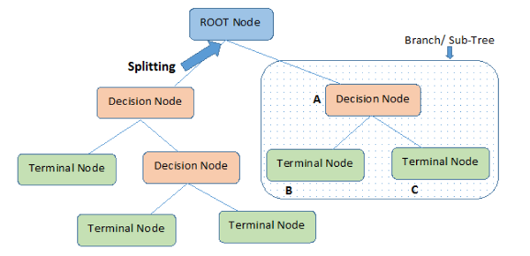
Decision Tree
A decision tree is a non-parametric supervised learning algorithm for classification and regression tasks. It has a hierarchical tree structure consisting of a root node, branches, internal nodes, and leaf nodes.

Slide 11
Working of Decision Tree
Step-1: Begin the tree with the root node, says S, which contains the complete dataset.
Step-2: Find the best attribute in the dataset using Attribute Selection Measure (ASM).
Step-3: Divide the S into subsets that contains possible values for the best attributes.
Step-4: Generate the decision tree node, which contains the best attribute.
Step-5: Recursively make new decision trees using the subsets of the dataset created in step -3. Continue this process until a stage is reached where you cannot further classify the nodes and called the final node as a leaf node.

Slide 12
Decision Tree Terminologies
Root Node: The initial node at the beginning of a decision tree, where the entire population or dataset starts dividing based on various features or conditions.
Decision Nodes: Nodes resulting from the splitting of root nodes are known as decision nodes. These nodes represent intermediate decisions or conditions within the tree.
Leaf Nodes: Nodes where further splitting is not possible, often indicating the final classification or outcome. Leaf nodes are also referred to as terminal nodes.
Sub-Tree: Similar to a subsection of a graph being called a sub-graph, a sub-section of a decision tree is referred to as a sub-tree. It represents a specific portion of the decision tree.
Pruning: The process of removing or cutting down specific nodes in a decision tree to prevent overfitting and simplify the model.
Branch / Sub-Tree: A subsection of the entire decision tree is referred to as a branch or sub-tree. It represents a specific path of decisions and outcomes within the tree.
Parent and Child Node: In a decision tree, a node that is divided into sub-nodes is known as a parent node, and the sub-nodes emerging from it are referred to as child nodes. The parent node represents a decision or condition, while the child nodes represent the potential outcomes or further decisions based on that condition.

Slide 13
Advantages and Disadvantages of the Decision Tree
Advantages of the Decision Tree
It is simple to understand as it follows the same process which a human follow while making any decision in real-life.
It can be very useful for solving decision-related problems.
It helps to think about all the possible outcomes for a problem.
There is less requirement of data cleaning compared to other algorithms.
Disadvantages of the Decision Tree
The decision tree contains lots of layers, which makes it complex.
It may have an overfitting issue, which can be resolved using the Random Forest algorithm.
For more class labels, the computational complexity of the decision tree may increase.

Slide 14
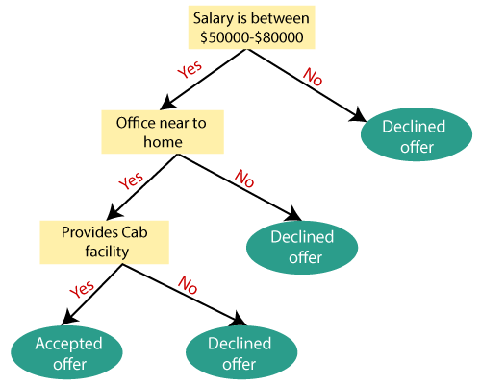
Example of Decision Tree
Suppose there is a candidate who has a job offer and wants to decide whether he should accept the offer or Not. So, to solve this problem, the decision tree starts with the root node (Salary attribute by ASM). The root node splits further into the next decision node (distance from the office) and one leaf node based on the corresponding labels. The next decision node further gets split into one decision node (Cab facility) and one leaf node. Finally, the decision node splits into two leaf nodes (Accepted offers and Declined offer).

Slide 15
Decision Tree Assumptions
Several assumptions are made to build effective models when creating decision trees. These assumptions help guide the tree’s construction and impact its performance. Here are some common assumptions and considerations when creating decision trees:
Binary Splits- Decision trees typically make binary splits, meaning each node divides the data into two subsets based on a single feature or condition. This assumes that each decision can be represented as a binary choice.
Recursive Partitioning- Decision trees use a recursive partitioning process, where each node is divided into child nodes, and this process continues until a stopping criterion is met. This assumes that data can be effectively subdivided into smaller, more manageable subsets.
Feature Independence- Decision trees often assume that the features used for splitting nodes are independent. In practice, feature independence may not hold, but decision trees can still perform well if features are correlated.
Homogeneity- Decision trees aim to create homogeneous subgroups in each node, meaning that the samples within a node are as similar as possible regarding the target variable. This assumption helps in achieving clear decision boundaries.
Top-Down Greedy Approach- Decision trees are constructed using a top-down, greedy approach, where each split is chosen to maximize information gain or minimize impurity at the current node. This may not always result in the globally optimal tree.

Slide 16
Decision Tree Assumptions
Categorical and Numerical Features- Decision trees can handle both categorical and numerical features. However, they may require different splitting strategies for each type.
Overfitting- Decision trees are prone to overfitting when they capture noise in the data. Pruning and setting appropriate stopping criteria are used to address this assumption.
Impurity Measures- Decision trees use impurity measures such as Gini impurity or entropy to evaluate how well a split separates classes. The choice of impurity measure can impact tree construction.
No Missing Values- Decision trees assume that there are no missing values in the dataset or that missing values have been appropriately handled through imputation or other methods.
Equal Importance of Features- Decision trees may assume equal importance for all features unless feature scaling or weighting is applied to emphasize certain features.
No Outliers- Decision trees are sensitive to outliers, and extreme values can influence their construction. Preprocessing or robust methods may be needed to handle outliers effectively.
Sensitivity to Sample Size- Small datasets may lead to overfitting, and large datasets may result in overly complex trees. The sample size and tree depth should be balanced.

Slide 17
Tree Pruning
Tree pruning is a technique used in decision tree-based machine learning models, including survival trees, to prevent overfitting and improve the generalization of the model. Pruning involves removing some branches (subtrees) of the tree, which helps to simplify the model and prevent it from becoming too complex, capturing noise in the training data.
There are two main types of tree pruning:
Pre-pruning (Early Stopping): In this approach, the tree is grown without any restrictions initially, and then, during the construction process, some of the branches are pruned based on certain conditions. Common stopping criteria include limiting the maximum depth of the tree, requiring a minimum number of samples in a leaf node, or setting a minimum information gain for a split. This helps to control the size of the tree during its construction.
Post-pruning (Pruning after Tree Construction): The tree is allowed to grow to its full depth, and then branches that do not contribute significantly to the predictive performance of the model are removed. This is typically done using a validation set or a cross-validation approach. The idea is to identify branches that, when pruned, result in a model with better generalization to unseen data.
Pruning is essential because decision trees, if left unchecked, can become overly complex and capture noise in the training data, leading to poor performance on new, unseen data. Pruning helps to strike a balance between capturing the underlying patterns in the data and avoiding overfitting.

Slide 18

Attribute Selection Measure
Entropy: Entropy is a measure of impurity or disorder in a set of data. In the context of decision trees, it is used to quantify the amount of uncertainty or randomness in a dataset before and after a split.
Here,
p₊ is the probability of positive class
p– is the probability of negative class
S is the subset of the training example
Information Gain: Information gain is the measurement of changes in entropy after the segmentation of a dataset based on an attribute. It calculates how much information a feature provides us about a class.
According to the value of information gain, we split the node and build the decision tree.
A decision tree algorithm always tries to maximize the value of information gain, and a node/attribute having the highest information gain is split first.
It is just entropy of the full dataset – entropy of the dataset given some feature.

Slide 19
Types of Decision Trees
There are two types of decision trees:
Classification Trees
Regression Trees.
From there, they are split into different algorithms and use various nodes and branches to make them whole. It’s absolutely imperative that you choose one that directly suits the purpose of your decision tree.
Classification trees: Classification trees determine whether an event happened or didn’t happen. Usually, this involves a “yes” or “no” outcome. . We often use this type of decision-making in the real world. Here are a few examples to help contextualize how decision trees work for classification:
Example 1: How to spend your free time after work
What you do after work in your free time can be dependent on the weather. If it is sunny, you might choose between having a picnic with a friend, grabbing a drink with a colleague, or running errands. If it is raining, you might opt to stay home and watch a movie instead. There is a clear outcome. In this case, that is classified as whether to “go out” or “stay in.”
Example 2: Homeownership based on age and income
In a classification tree, the data set splits according to its variables. There are two variables, age and income, that determine whether or not someone buys a house. If training data tells us that 70 percent of people over age 30 bought a house, then the data gets split there, with age becoming the first node in the tree. This split makes the data 80 percent “pure.” The second node then addresses income from there.
Regression trees: Regression trees, on the other hand, predict continuous values based on previous data or information sources. For example, they can predict the price of gasoline or whether a customer will purchase eggs (including which type of eggs and at which store).
This type of decision-making is more about programming algorithms to predict what is likely to happen, given previous behavior or trends.
Example 1: Housing prices in Colorado
Regression analysis could be used to predict the price of a house in Colorado, which is plotted on a graph. The regression model can predict housing prices in the coming years using data points of what prices have been in previous years. This relationship is a linear regression since housing prices are expected to continue rising. Machine learning helps us predict specific prices based on a series of variables that have been true in the past.
Example 2: Bachelor’s degree graduates in 2025
A regression tree can help a university predict how many bachelor’s degree students there will be in 2025. On a graph, one can plot the number of degree-holding students between 2010 and 2022. If the number of university graduates increases linearly each year, then regression analysis can be used to build an algorithm that predicts the number of students in 2025.

Slide 20
Types of decision tree algorithms
ID3
Iterative Dichotomiser 3, or ID3, developed by Ross Quinlan in 1983, is a nominal decision tree used to split two or more features into groups at every step.
It uses a top-down greedy approach, which means you start from the top and go down, while "greedy" means you pick the best option at that particular moment and move to the next step.
Chi-Square
Also known as CHAID (Chi-Squared automatic interaction detection) is a highly visual and easy-to-understand decision tree that uses input variables to help decide the best possible result.
These can often be used in direct marketing situations where having an idea of how participants are likely to best respond would be helpful.
Chi-square also allows for much more precision and accuracy because nodes can be split multiple times and allow for more data to be processed.
Reduction in Variance
This algorithm splits the chosen nodes in a continuously changing target variable.
It’s named after the fact that it uses variance to measure and decide how nodes are split into child nodes or sub-nodes.

Slide 21
When to Stop Splitting ?
Usually, real-world datasets have a large number of features, which will result in a large number of splits, which in turn gives a huge tree. Such trees take time to build and can lead to overfitting. That means the tree will give very good accuracy on the training dataset but will give bad accuracy in test data.
There are many ways to tackle this problem through hyperparameter tuning. We can set the maximum depth of our decision tree using the max_depth parameter. The more the value of max_depth, the more complex your tree will be. The training error will off-course decrease if we increase the max_depth value but when our test data comes into the picture, we will get a very bad accuracy. Hence you need a value that will not overfit as well as underfit our data and for this, you can use GridSearchCV.
Another way is to set the minimum number of samples for each spilt. It is denoted by min_samples_split. Here we specify the minimum number of samples required to do a spilt. For example, we can use a minimum of 10 samples to reach a decision. That means if a node has less than 10 samples then using this parameter, we can stop the further splitting of this node and make it a leaf node.
There are more hyperparameters such as:
min_samples_leaf – represents the minimum number of samples required to be in the leaf node. The more you increase the number, the more is the possibility of overfitting.
max_features – it helps us decide what number of features to consider when looking for the best split.

Slide 22

Support Vector Machine
Support Vector Machine or SVM is one of the most popular Supervised Learning algorithms, which is used for Classification as well as Regression problems. However, primarily, it is used for Classification problems in Machine Learning.
The goal of the SVM algorithm is to create the best line or decision boundary that can segregate n-dimensional space into classes so that we can easily put the new data point in the correct category in the future. This best decision boundary is called a hyperplane.
SVM chooses the extreme points/vectors that help in creating the hyperplane. These extreme cases are called as support vectors, and hence algorithm is termed as Support Vector Machine. Consider the diagram in which there are two different categories that are classified using a decision boundary or hyperplane:

Slide 23
Types of SVM
Linear SVM- Linear SVMs use a linear kernel to create a straight-line decision boundary that separates different classes. They are effective when the data is linearly separable or when a linear approximation is sufficient. Linear SVMs are computationally efficient and have good interpretability, as the decision boundary is a hyperplane in the input feature space.
Nonlinear SVM- Nonlinear SVMs address scenarios where the data cannot be separated by a straight line in the input feature space. They achieve this by using kernel functions that implicitly map the data into a higher-dimensional feature space, where a linear decision boundary can be found.
Popular kernel functions used in this type of SVM include the polynomial kernel, Gaussian (RBF) kernel and sigmoid kernel. Nonlinear SVMs can capture complex patterns and achieve higher classification accuracy when compared to linear SVMs.

Slide 24
Support Vector Machine Terminology
Hyperplane: Hyperplane is the decision boundary that is used to separate the data points of different classes in a feature space. In the case of linear classifications, it will be a linear equation i.e. wx+b = 0.
Support Vectors: Support vectors are the closest data points to the hyperplane, which makes a critical role in deciding the hyperplane and margin.
Margin: Margin is the distance between the support vector and hyperplane. The main objective of the support vector machine algorithm is to maximize the margin. The wider margin indicates better classification performance.
Kernel: Kernel is the mathematical function, which is used in SVM to map the original input data points into high-dimensional feature spaces, so, that the hyperplane can be easily found out even if the data points are not linearly separable in the original input space. Some of the common kernel functions are linear, polynomial, radial basis function(RBF), and sigmoid.
Hard Margin: The maximum-margin hyperplane or the hard margin hyperplane is a hyperplane that properly separates the data points of different categories without any misclassifications.
Soft Margin: When the data is not perfectly separable or contains outliers, SVM permits a soft margin technique. Each data point has a slack variable introduced by the soft-margin SVM formulation, which softens the strict margin requirement and permits certain misclassifications or violations. It discovers a compromise between increasing the margin and reducing violations.
C: Margin maximisation and misclassification fines are balanced by the regularisation parameter C in SVM. The penalty for going over the margin or misclassifying data items is decided by it. A stricter penalty is imposed with a greater value of C, which results in a smaller margin and perhaps fewer misclassifications.
Hinge Loss: A typical loss function in SVMs is hinge loss. It punishes incorrect classifications or margin violations. The objective function in SVM is frequently formed by combining it with the regularisation term.
Dual Problem: A dual Problem of the optimisation problem that requires locating the Lagrange multipliers related to the support vectors can be used to solve SVM. The dual formulation enables the use of kernel tricks and more effective computing.

Slide 25
Advantages and Disadvantages of Support Vector Machine
Advantages:
SVM works relatively well when there is a clear margin of separation between classes.
SVM is more effective in high dimensional spaces.
SVM is effective in cases where the number of dimensions is greater than the number of samples.
SVM is relatively memory efficient
Disadvantages:
SVM algorithm is not suitable for large data sets.
SVM does not perform very well when the data set has more noise i.e. target classes are overlapping.
In cases where the number of features for each data point exceeds the number of training data samples, the SVM will underperform.
As the support vector classifier works by putting data points, above and below the classifying hyperplane there is no probabilistic explanation for the classification.

Slide 26
Naive Bayes
Naive Bayes classifiers are a collection of classification algorithms based on Bayes’ Theorem. It is not a single algorithm but a family of algorithms where all of them share a common principle, i.e. every pair of features being classified is independent of each other. To start with, let us consider a dataset.
One of the most simple and effective classification algorithms, the Naïve Bayes classifier aids in the rapid development of machine learning models with rapid prediction capabilities.
The “Naive” part of the name indicates the simplifying assumption made by the Naïve Bayes classifier. The classifier assumes that the features used to describe an observation are conditionally independent, given the class label. The “Bayes” part of the name refers to Reverend Thomas Bayes, an 18th-century statistician and theologian who formulated Bayes’ theorem.

Slide 27
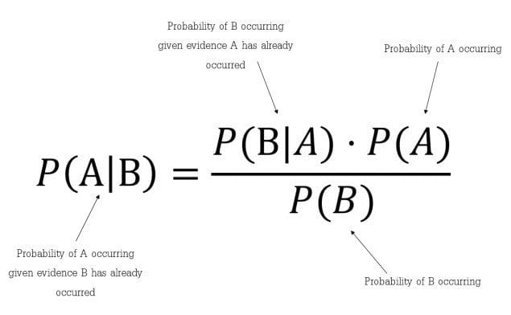
Bayes Theorem
Bayes’ Theorem is a simple mathematical formula used for calculating conditional probabilities.
Conditional probability is a measure of the probability of an event occurring given that another event has (by assumption, presumption, assertion, or evidence) occurred.
The formula is: —
Which tells us: how often A happens given that B happens, written P(A|B) also called posterior probability, When we know: how often B happens given that A happens, written P(B|A) and how likely A is on its own, written P(A) and how likely B is on its own, written P(B).
In simpler terms, Bayes’ Theorem is a way of finding a probability when we know certain other probabilities.

Slide 28
Pros and Cons of Naive Bayes
Pros:
It is easy and fast to predict class of test data set. It also perform well in multi class prediction
When assumption of independence holds, the classifier performs better compared to other machine learning models like logistic regression or decision tree, and requires less training data.
It perform well in case of categorical input variables compared to numerical variable(s). For numerical variable, normal distribution is assumed (bell curve, which is a strong assumption).
Cons:
If categorical variable has a category (in test data set), which was not observed in training data set, then model will assign a 0 (zero) probability and will be unable to make a prediction. This is often known as “Zero Frequency”. To solve this, we can use the smoothing technique. One of the simplest smoothing techniques is called Laplace estimation.
On the other side, Naive Bayes is also known as a bad estimator, so the probability outputs from predict_proba are not to be taken too seriously.
Another limitation of this algorithm is the assumption of independent predictors. In real life, it is almost impossible that we get a set of predictors which are completely independent.

Slide 29
Applications of Naive Bayes Algorithms
Real-time Prediction: Naive Bayesian classifier is an eager learning classifier and it is super fast. Thus, it could be used for making predictions in real time.
Multi-class Prediction: This algorithm is also well known for multi class prediction feature. Here we can predict the probability of multiple classes of target variable.
Text classification/ Spam Filtering/ Sentiment Analysis: Naive Bayesian classifiers mostly used in text classification (due to better result in multi class problems and independence rule) have higher success rate as compared to other algorithms. As a result, it is widely used in Spam filtering (identify spam e-mail) and Sentiment Analysis (in social media analysis, to identify positive and negative customer sentiments)
Recommendation System: Naive Bayes Classifier and Collaborative Filtering together builds a Recommendation System that uses machine learning and data mining techniques to filter unseen information and predict whether a user would like a given resource or not.

Slide 30
Bayesian Network
Bayesian belief network is key computer technology for dealing with probabilistic events and to solve a problem which has uncertainty. We can define a Bayesian network as:
"A Bayesian network is a probabilistic graphical model which represents a set of variables and their conditional dependencies using a directed acyclic graph."
It is also called a Bayes network, belief network, decision network, or Bayesian model.
Bayesian networks are probabilistic, because these networks are built from a probability distribution, and also use probability theory for prediction and anomaly detection.

Slide 31
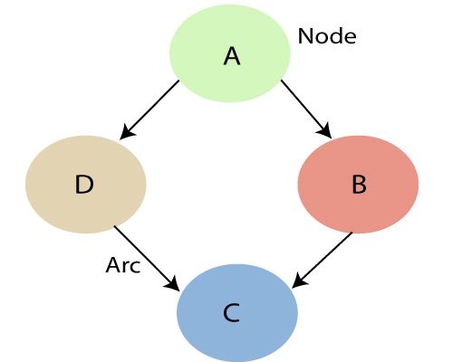
Bayesian Network
Bayesian Network can be used for building models from data and experts opinions, and it consists of two parts:
Directed Acyclic Graph
Table of conditional probabilities.
The generalized form of Bayesian network that represents and solve decision problems under uncertain knowledge is known as an Influence diagram.
A Bayesian network graph is made up of nodes and Arcs (directed links), where:
Each node corresponds to the random variables, and a variable can be continuous or discrete.
Arc or directed arrows represent the causal relationship or conditional probabilities between random variables. These directed links or arrows connect the pair of nodes in the graph.
These links represent that one node directly influence the other node, and if there is no directed link that means that nodes are independent with each other
In the above diagram, A, B, C, and D are random variables represented by the nodes of the network graph.
If we are considering node B, which is connected with node A by a directed arrow, then node A is called the parent of Node B.
Node C is independent of node A.

Slide 32
Bayesian Network
Bayesian network is based on Joint probability distribution and conditional probability. So let's first understand the joint probability distribution:
Joint probability distribution:
If we have variables x1, x2, x3,....., xn, then the probabilities of a different combination of x1, x2, x3.. xn, are known as Joint probability distribution.
P[x₁, x₂, x₃,....., x_{n}], it can be written as the following way in terms of the joint probability distribution.
= P[x₁| x₂, x₃,....., x_{n}]P[x₂, x₃,....., x_{n}]
= P[x₁| x₂, x₃,....., x_{n}]P[x₂|x₃,....., x_{n}]....P[x_{n-1}|x_{n}]P[x_{n}].
In general for each variable Xi, we can write the equation as:
P(Xi|Xi-1,........., X1) = P(Xi |Parents(Xi ))

Slide 33
Pros and Cons of Bayesian Network
Pros:
Expressive Modeling of Uncertainty: Bayesian Networks are well-suited for representing and modeling uncertain relationships between variables. They can capture dependencies, conditional probabilities, and uncertainties in a systematic manner.
Intuitive Representation: The graphical representation of Bayesian Networks provides an intuitive way to understand and communicate complex probabilistic relationships. The structure of the graph visually represents the conditional dependencies among variables.
Efficient Inference: Bayesian Networks allow for efficient and scalable probabilistic inference. Once the network is trained, it can be used to quickly compute probabilities and make predictions based on observed evidence.
Handling Incomplete Data: Bayesian Networks can handle incomplete or missing data during the inference process. This is useful in real-world scenarios where not all variables may be observed.
Causal Reasoning: Bayesian Networks inherently capture causal relationships among variables, allowing for reasoning about the impact of interventions and understanding cause-and-effect relationships.
Cons:
Computational Complexity: The inference process in Bayesian Networks can be computationally intensive, especially for large and complex networks. This complexity increases as the number of variables and dependencies grows.
Learning the Structure: Determining the optimal structure of a Bayesian Network can be challenging. Learning the network structure from data requires a sufficient amount of data and can be sensitive to noisy or incomplete data.
Assumption of Conditional Independence: Bayesian Networks rely on the assumption of conditional independence among variables given their parents in the graph. This assumption may not always hold in real-world situations.
Knowledge Elicitation: Constructing a Bayesian Network often requires domain knowledge to specify the structure and conditional probabilities. Obtaining accurate probabilities can be challenging, especially if expert knowledge is not readily available.
Limited Representational Power: While Bayesian Networks are expressive, they may struggle to represent certain types of dependencies, such as cyclic dependencies, feedback loops, or non-Gaussian distributions.

Slide 34

Support Vector Machine
SVM is a powerful supervised algorithm that works best on smaller datasets but on complex ones.
Support Vector Machine, abbreviated as SVM can be used for both regression and classification tasks, but generally, they work best in classification problems.
The goal of the SVM algorithm is to create the best line or decision boundary that can segregate n-dimensional space into classes so that we can easily put the new data point in the correct category in the future. This best decision boundary is called a hyperplane.
SVM chooses the extreme points/vectors that help in creating the hyperplane. These extreme cases are called as support vectors, and hence algorithm is termed as Support Vector Machine.
Consider the below diagram in which there are two different categories that are classified using a decision boundary or hyperplane:

Slide 35
Hyperplane and Support Vectors
Hyperplane: There can be multiple lines/decision boundaries to segregate the classes in n-dimensional space, but we need to find out the best decision boundary that helps to classify the data points. This best boundary is known as the hyperplane of SVM.
The dimensions of the hyperplane depend on the features present in the dataset, which means if there are 2 features (as shown in image), then hyperplane will be a straight line. And if there are 3 features, then hyperplane will be a 2-dimension plane.
We always create a hyperplane that has a maximum margin, which means the maximum distance between the data points.
Support Vectors: The data points or vectors that are the closest to the hyperplane and which affect the position of the hyperplane are termed as Support Vector. Since these vectors support the hyperplane, hence called a Support vector.

Slide 36
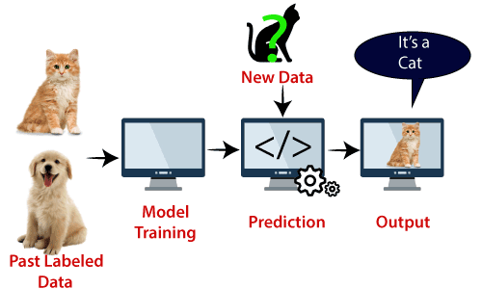
Example SVM
SVM can be understood with the example that we have used in the KNN classifier. Suppose we see a strange cat that also has some features of dogs, so if we want a model that can accurately identify whether it is a cat or dog, so such a model can be created by using the SVM algorithm.
We will first train our model with lots of images of cats and dogs so that it can learn about different features of cats and dogs, and then we test it with this strange creature. So as support vector creates a decision boundary between these two data (cat and dog) and choose extreme cases (support vectors), it will see the extreme case of cat and dog. On the basis of the support vectors, it will classify it as a cat. Consider the below diagram:

Slide 37
Types of SVM
Linear SVM: Linear SVM is used for linearly separable data, which means if a dataset can be classified into two classes by using a single straight line, then such data is termed as linearly separable data, and classifier is used called as Linear SVM classifier.
Non-linear SVM: Non-Linear SVM is used for non-linearly separated data, which means if a dataset cannot be classified by using a straight line, then such data is termed as non-linear data and classifier used is called as Non-linear SVM classifier.

Slide 38
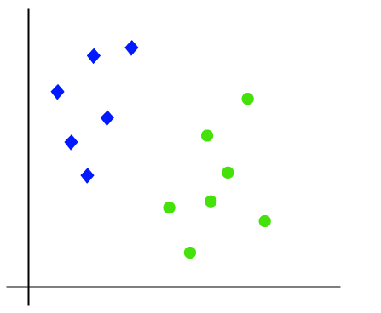
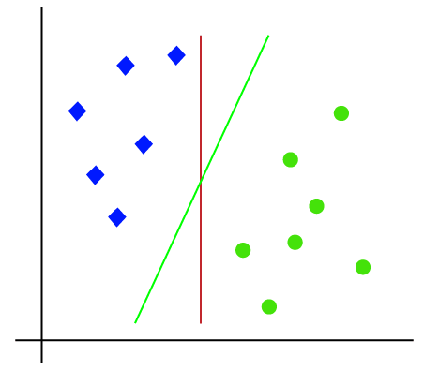
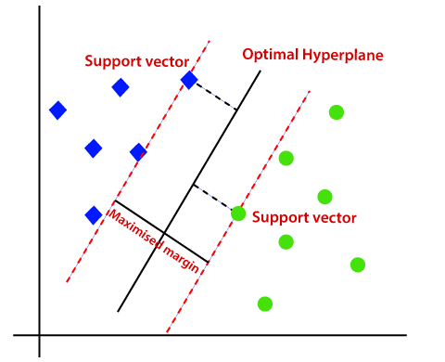
Working of Linear SVM
The working of the SVM algorithm can be understood by using an example. Suppose we have a dataset that has two tags (green and blue), and the dataset has two features x1 and x2. We want a classifier that can classify the pair(x1, x2) of coordinates in either green or blue. Consider the below image:
Hence, the SVM algorithm helps to find the best line or decision boundary; this best boundary or region is called as a hyperplane.
SVM algorithm finds the closest point of the lines from both the classes. These points are called support vectors. The distance between the vectors and the hyperplane is called as margin.
And the goal of SVM is to maximize this margin. The hyperplane with maximum margin is called the optimal hyperplane.
So as it is 2-d space so by just using a straight line, we can easily separate these two classes. But there can be multiple lines that can separate these classes.

Slide 39
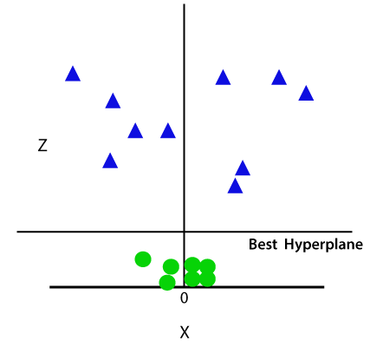
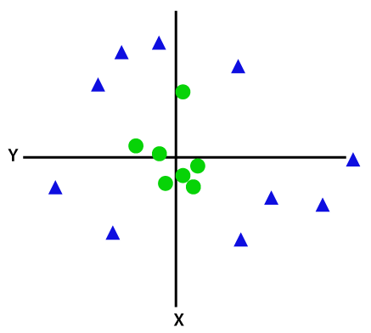
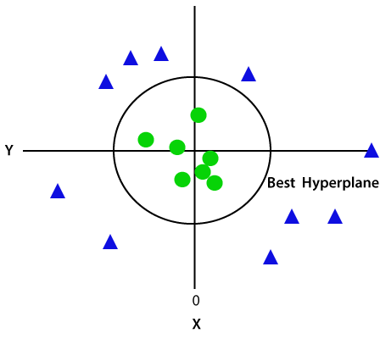
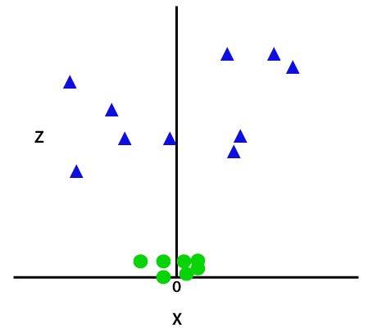
Working of Non- Linear SVM
If data is linearly arranged, then we can separate it by using a straight line, but for non-linear data, we cannot draw a single straight line. Consider the below image:
So now, SVM will divide the datasets into classes in the following way. Consider the below image:
Since we are in 3-d Space, hence it is looking like a plane parallel to the x-axis. If we convert it in 2d space with z=1, then it will become as:
Hence we get a circumference of radius 1 in case of non-linear data.
So to separate these data points, we need to add one more dimension. For linear data, we have used two dimensions x and y, so for non-linear data, we will add a third dimension z. It can be calculated as:
z=x^2 +y^2
By adding the third dimension, the sample space will become as below image:

Slide 40
Advantages and Disadvantages of Support Vector Machine (SVM)
Advantages of Support Vector Machine (SVM)
Disadvantages of Support Vector Machine (SVM)
Regularization capabilities: SVM has L2 Regularization feature. So, it has good generalization capabilities which prevent it from over-fitting.
Handles non-linear data efficiently: SVM can efficiently handle non-linear data using Kernel trick.
Solves both Classification and Regression problems: SVM can be used to solve both classification and regression problems. SVM is used for classification problems while SVR (Support Vector Regression) is used for regression problems.
Stability: A small change to the data does not greatly affect the hyperplane and hence the SVM. So the SVM model is stable.
Choosing an appropriate Kernel function is difficult: Choosing an appropriate Kernel function (to handle the non-linear data) is not an easy task. It could be tricky and complex. In case of using a high dimension Kernel, you might generate too many support vectors which reduce the training speed drastically.
Extensive memory requirement: Algorithmic complexity and memory requirements of SVM are very high. You need a lot of memory since you have to store all the support vectors in the memory and this number grows abruptly with the training dataset size.
Requires Feature Scaling: One must do feature scaling of variables before applying SVM.
Long training time: SVM takes a long training time on large datasets.
Difficult to interpret: SVM model is difficult to understand and interpret by human beings unlike Decision Trees.

